Slide 1

7th Semester
Project Presentation
on
“EYE OF GOD: Missing person detection using AI”
Presented by
Shamith Mylar J (USN: 4NN20IS040)
Md. Faraaz Ahmed(USN : 4NN20IS025)
Nishan Rupesh(USN :4NN20IS028)
Manoj M(USN :4NN20IS020)
Under the guidance of
Mrs. Shruthi BS
Asst. Professor, Department of ISE, NIE Institute of Technology
NIE Institute of Technology, Mysore

Slide 2


A Project Presentation on
“Missing Person Detection System”
Index
Introduction
Literature Survey
Problem Identification
Software & Hardware Req.
Objectives and Methodology
Future Scope
Benefits and Impact
Conclusion
Q&A

Slide 3
A Project Presentation on
“Missing Person Detection System”
Introduction
Every day, countless individuals, including children, youth, and the elderly, go missing in our society.
Despite the best efforts of law enforcement, the process of locating missing persons is often fraught with challenges.
The 'Missing Person Detection System Using AI.' A Revolutionary Web-Based Application Utilizing Machine Learning and Facial Recognition
Let's explore how this transformative project aims to revolutionize the way we approach and expedite missing person investigations

Slide 4
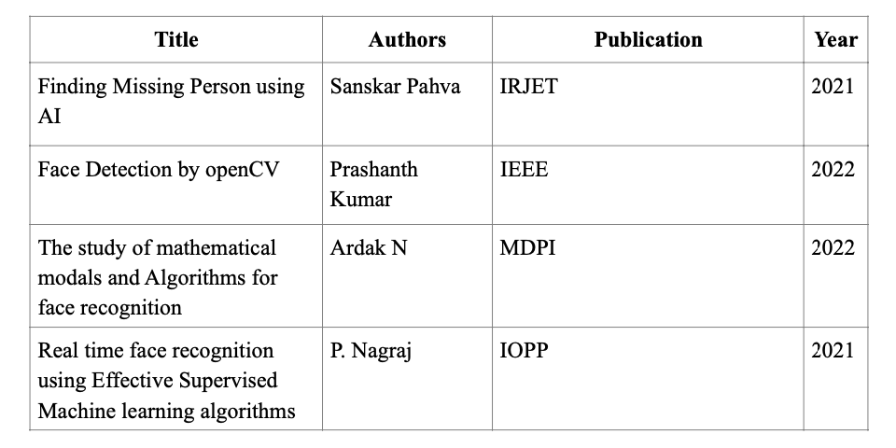
A Project Presentation on
“Missing Person Detection System”
Literature Survey

Slide 5

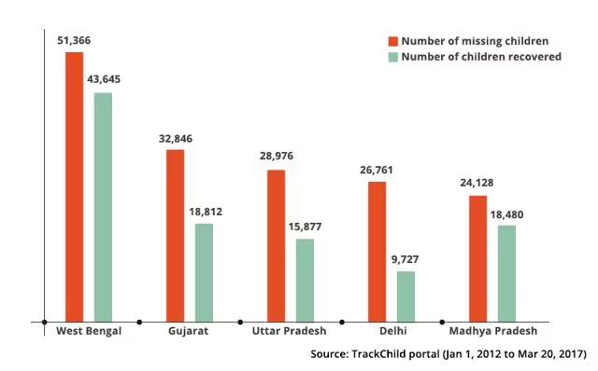
A Project Presentation on
“Missing Person Detection System”
Problem Identification
Graphs of Missing children across India

Slide 6
A Project Presentation on
“Missing Person Detection System”
Objectives
Objectives:
Streamline missing person search.
Reduce investigation times.
Provide timely notifications to authorities and family members.
System Features:
Advanced facial recognition algorithms.
User uploads images of missing persons.
Cross-references with a comprehensive database.
Generates alerts on finding a match.
User Roles:
Family members: Upload images and information.
Law enforcement: Efficiently manage and retrieve data through the database.

Slide 7
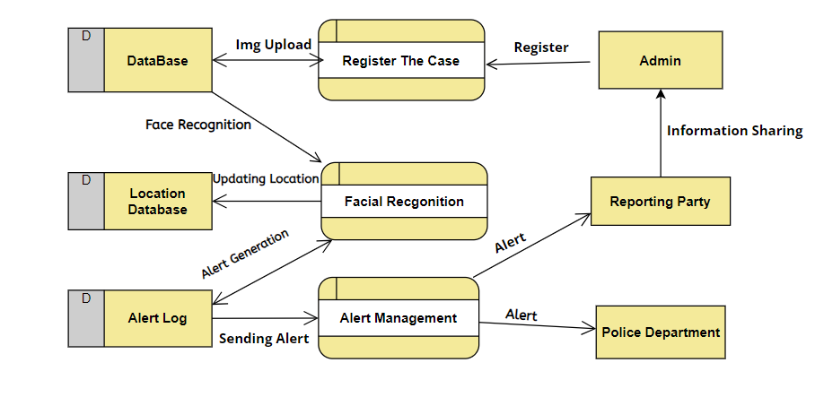
A Project Presentation on
“Missing Person Detection System”
Methodology
Data Flow Diagram

Slide 8
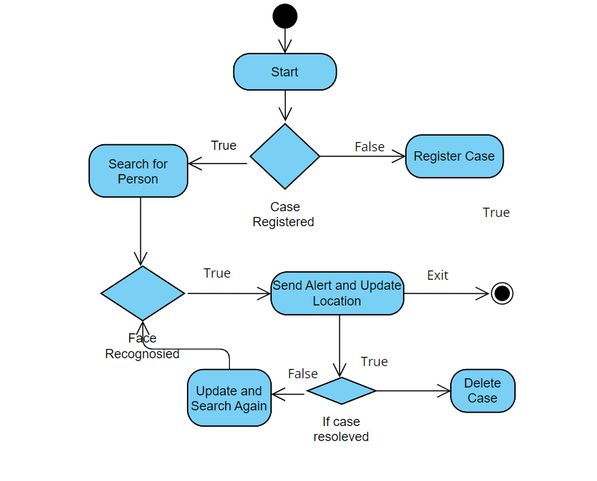
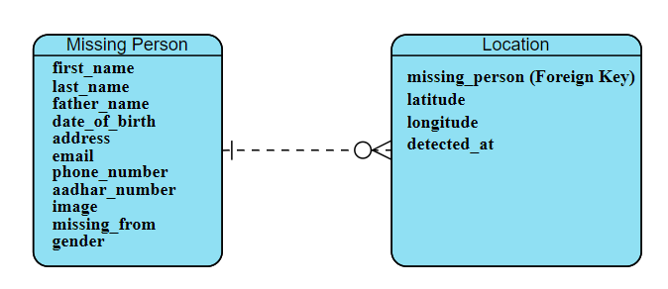
A Project Presentation on
“Missing Person Detection System”
Methodology
ER Diagram
Activity Diagram

Slide 9
A Project Presentation on
“Missing Person Detection System”
Hardware & Software Requirements
Languages Used:
Python
Django
HTML/CSS/Javascript/Bootstrap
Libraries:
OpenCV
Face-recognition
IDE:
VsCode

Slide 10
A Project Presentation on
“Missing Person Detection System”
Future Scope
Real-Time Video Analysis Integration.
Mobile Application Development.
Collaboration with Law Enforcement Agencies,
Integration with Social Media Platforms.
Integration with Public Services.
Implementing encryption protocols and data privacy.
Incorporating geolocation services and camera metadata.
Deploying the system on cloud services like AWS, Azure, or Google Cloud.

Slide 11
A Project Presentation on
“Missing Person Detection System”
Expected Outcome
Rapid image uploads allow for quicker initiation of the search process.
OpenCV & face-recognition ensures precise facial feature extraction, enhancing the accuracy of face encodings during matching.
Organized database ensures comparison during facial recognition
Automatic alert generation for authorities and concerned individuals.
Reduces the overall time and resources traditionally required for missing person investigations.
The project sets the stage for advancements in missing person detection, with potential applications extending beyond current boundaries.

Slide 12
A Project Presentation on
“Missing Person Detection System”
Conclusion
Significance of the Missing Person Detection System: Revolutionizing the search for missing individuals.
Potential for Saving Lives: Timely identification and rescue of missing persons.
Contribution to Society: Enhancing public safety and reducing anxiety among families of missing persons.

Slide 13
A Project Presentation on
“Missing Person Detection System”
References
[1]. A. Smith, B. Johnson, C. Anderson, et al., "A Comprehensive Review on Missing Person Detection Systems," International Journal of Advanced Research in Computer Science, vol. 4, no. 8, 2021.
[2]. J. Kim, S. Park, K. Lee, et al., "Real-time Missing Person Detection Using Machine Learning Algorithms," Journal of Intelligent Systems, vol. 7, no. 3, 2020.
[3]. S. Patel, R. Gupta, N. Sharma, et al., "Smart Surveillance: A Framework for Missing Person Detection and Recognition," International Journal of Computer Applications, vol. 9, no. 12, 2018.
[4]. National Crime Records Bureau, "Crime in India - 2020," Ministry of Home Affairs, Government of India, December 2020. [Online]. Available: https://ncrb.gov.in/en/crime-india-2020. [Accessed 15 September 2021].

Slide 14
A Project Presentation on
“Missing Person Detection System”
THANK YOU!!

